Slide 1

ME 781 Project Demonstration ppt
Group 16:
Aneri modi (190100015)
Pari lalit vermani (190100089)
Dnyandeep kale (180100041)
Supratim sengupta (203110031)
Nikhil h parpay (213100079)

Slide 2
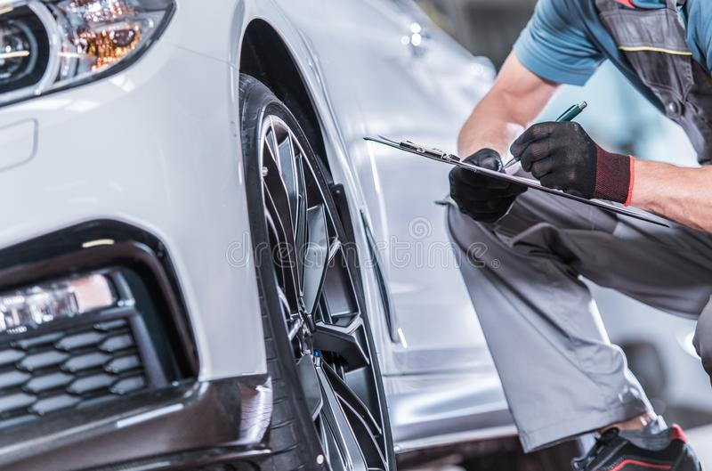
Who we are
DOING IT OUR WAY
Mission
Provide the finest automobile management services in affordable price range
Driver behavior analytics
Suitable insurance policy
Maintenance plan
Vision
Believe in providing the highest level of service in all areas of our expertise
Go the extra mile to provide you with an unparalleled level of service
Goal
To be a vehicle service leader
Do whatever it takes to earn your trust

Slide 3
Project definition
Most fleet owners require to optimise vehicle insurance and effective instantaneous maintenance solutions to provide a quick fix on the vehicle damage
A lot of research work is going on in this field and many more ML and deep learning models are there for instance, Merchants Fleet
We provide a generalised solution for all which does not require any extensive database from the consumer
An extensive array of factors taken into account before suggesting the insurance, hence Highly reliable; Generalised platform, hence caterable to a wide variety of customers
Business Case: Online event for introduction of product, advertising on google platform and YouTube, free access of software to research and industrial organizations

Slide 4
Highly Reliable
Generalised Platform
Less Data Requirement
Insurance Policy Optimisation
Driver & Vehicle Safety
Effective Maintenance Plan
USP

Slide 5

Technology landscape assessment
Patents:
Vehicle fleet control systems and methods: [Ryder Integrated Logistics Inc, USPTO]
Shared vehicle management method, server and computer readable storage medium: [Shenzen Echiev autonomous driving technology, Esapacenet]
Health monitoring systems and methods with vehicle identification: [ Honeywell International Inc, USTPO]
Electric vehicle fleet charging systems [ USTPO]
Method and system for managing a fleet of remote assets and/ or ascertain a repair for an asset [General Electrics Co, USTPO]

Slide 6
Technology landscape assessment cont.
Current Publications:
Strategic vehicle management-a joint solution of composition and replacement problems: [Redmer Adam (2020) Journal of quality in maintenance engineering]
Data driven fleet management :a perspective of risk management: [Rane, Santosh B(2020) Journal of modelling in management]
Digital fleet Management : A scalable cloud framework on data driven prediction models [Thomas et al. Annual conference of the PHM society (2020)]

Slide 7
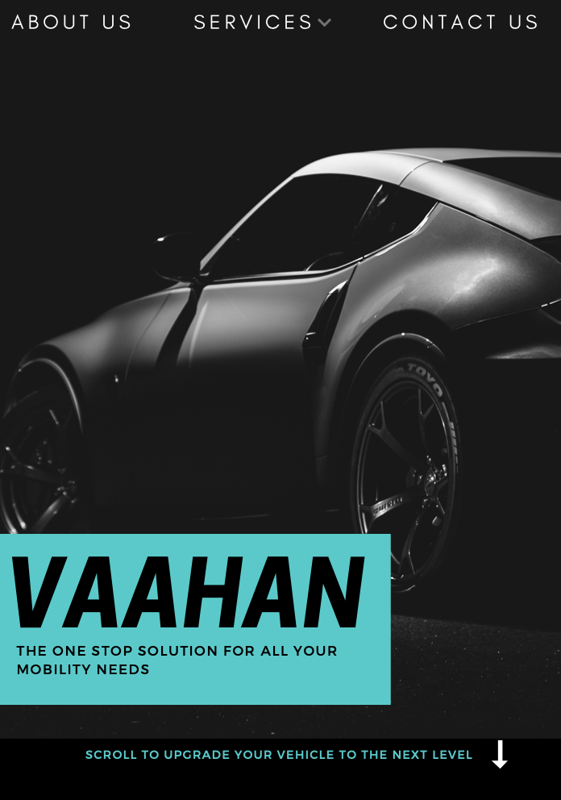
Demonstration of our portal: Main page
Vaahan will be accessible in website form
Attached is the image of the home page of this website
About Us talks about our start-up and it's values, principles, motivations and future aspirations
Services is the section where the user can go to in order to avail of the product, and where the payment portal will lie
Contact us will provide the location, contact number and a portal for the viewer to write to us from
There will also be a live chat option to allow for better accessibility and communication with our consumers

Slide 8
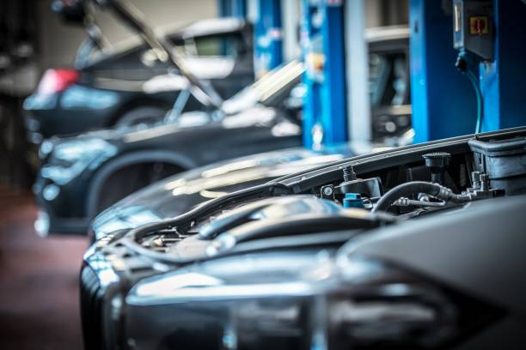
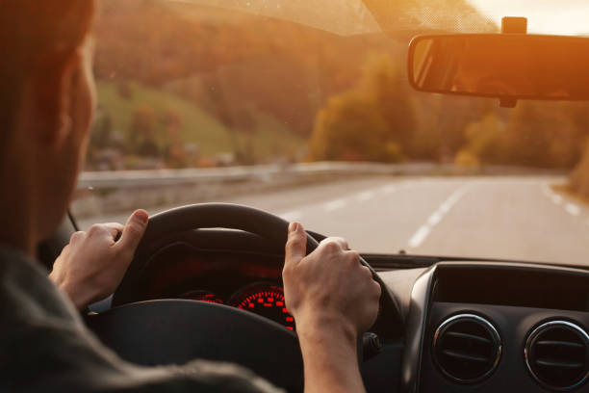

Vaahan: Our services
DAMAGE IDENTIFICATION
DRIVER ANALYTICS
INSURANCE
You’re a busy person — don’t let vehicle problems get in your way. Vaahan has the proper equipment and experience to locate, repair and/or replace the issue quickly and effectively. Use our products to take care of your Maintenance needs today.
We know that while on the road, safety is paramount. Use our driver behaviour analytics software and rest assured that you would have a great ride, with safety ensured.
Use your resources wisely. Identify the clients that would be interested in your insurance schemes, simply by providing some basic information on them. The optimization of your resource, is our priority.

Slide 9
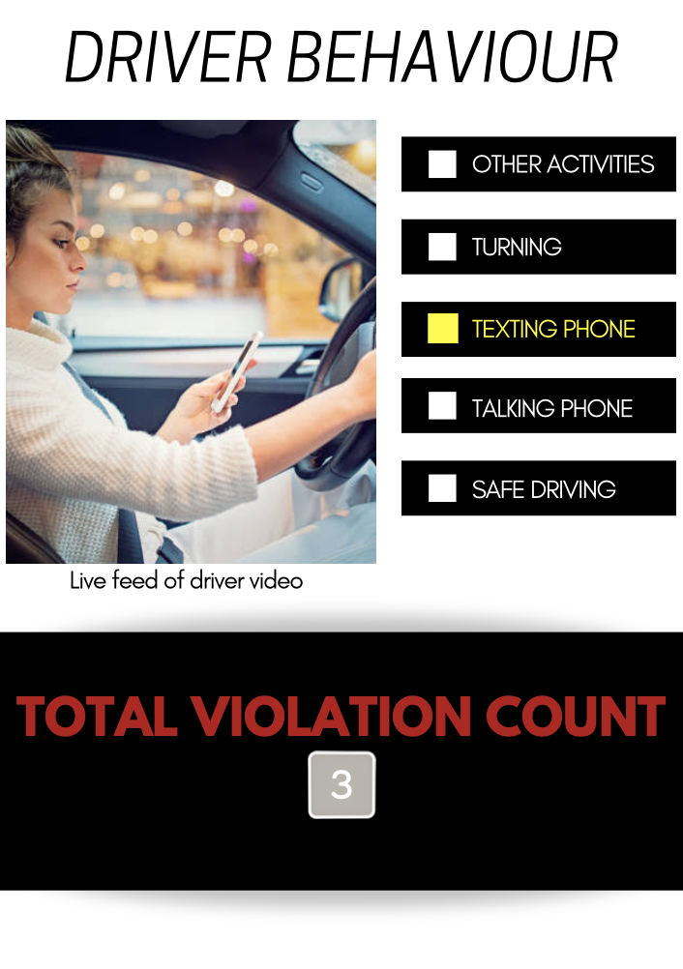
Driver behavior analytics
This is a paid feature of the website, this page will only be accessible once the consumer has paid and received login details to access this service
Here, the consumer must provide the live feed of the driver, and has a fixed amount of time they can avail of our analytics, based on how many hours they have paid for
There are five behaviors the software looks out for, whichever is valid at that point will be glowing in yellow, as shown in the image
There is also a counter keeping track of how many violations have occurred in the given timeframe for the driver

Slide 10
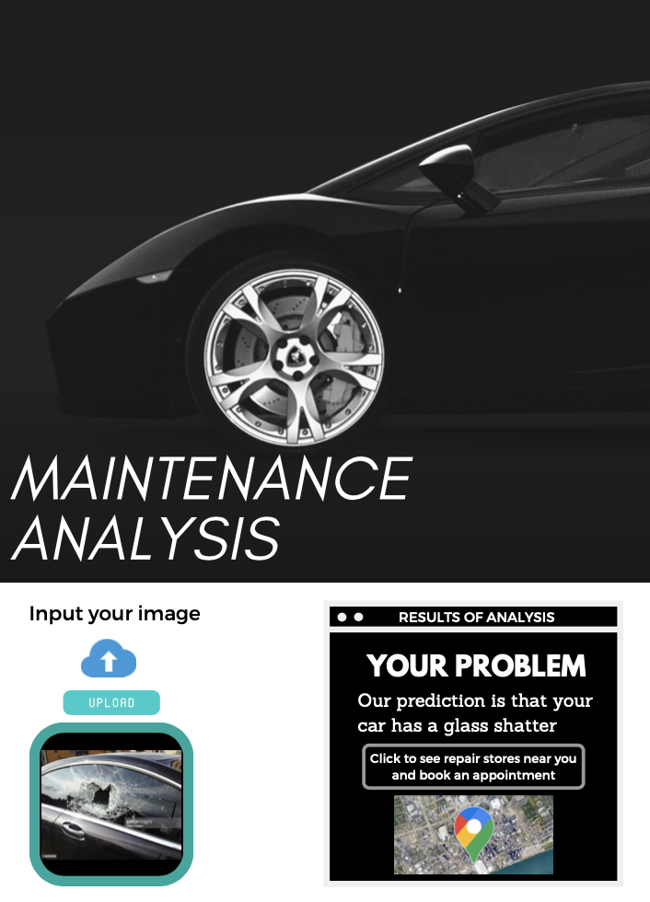
Vehicle damage classification
This is a paid feature of the website, this page will only be accessible once the consumer has paid and received login details to access this service
The user simply has to upload an image of the vehicle damage, and our software will identify what kind of damage it is
Along with this, the software will use the consumer's current location, and find the nearest maintenance or repair shop, and also connect the customer to book an appointment at the earliest

Slide 11
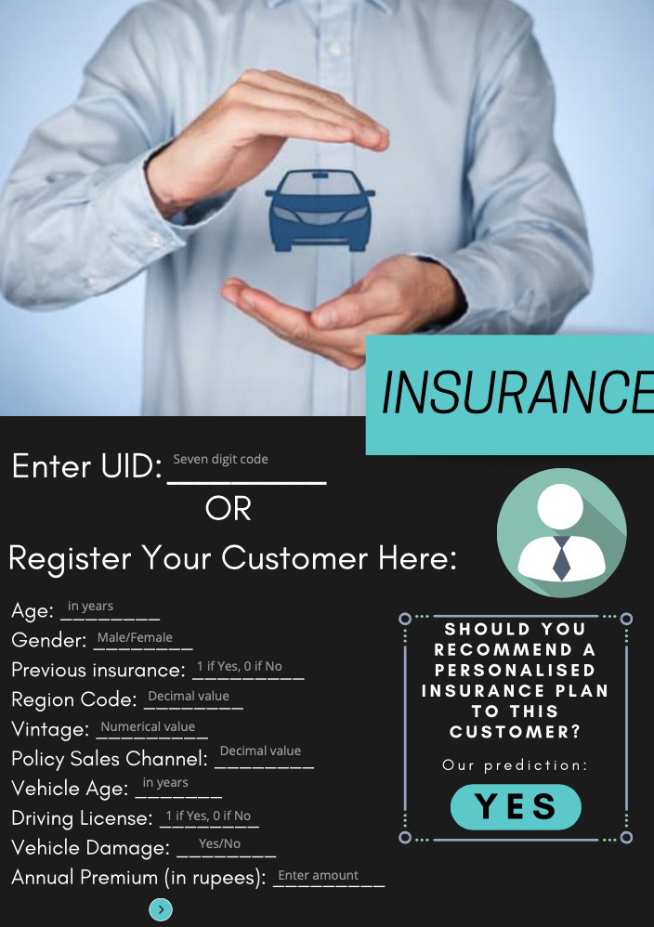
Vehicle insurance interest prediction
This is a paid feature of the website, this page will only be accessible once the consumer has paid and received login details to access this service
At Vaahan, we recognize that every business has to optimize its resources to function best
Thus, we use analytics to tell businesses if a customer is likely to be interested in getting a car insurance, based on some of the basic customer information
We also maintain a database of regular clients and every customer is alloted a special UID
New customers must register first to save their client details on our database

Slide 12
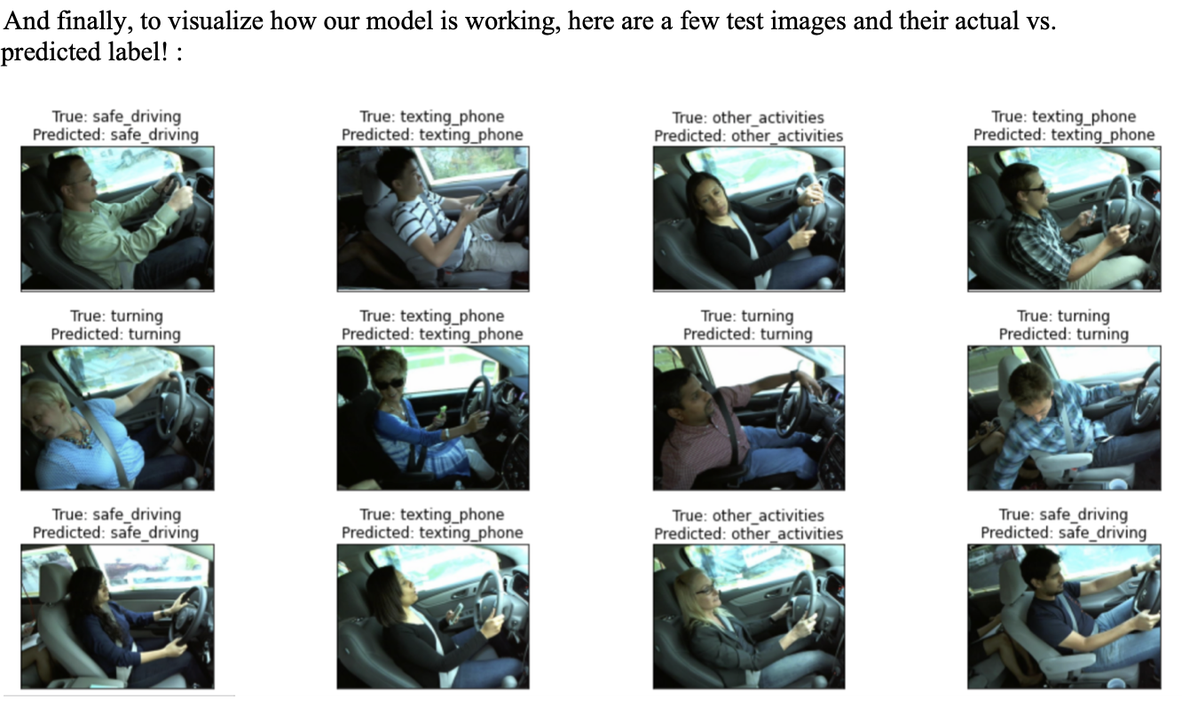
Driver behavior classification

Slide 13
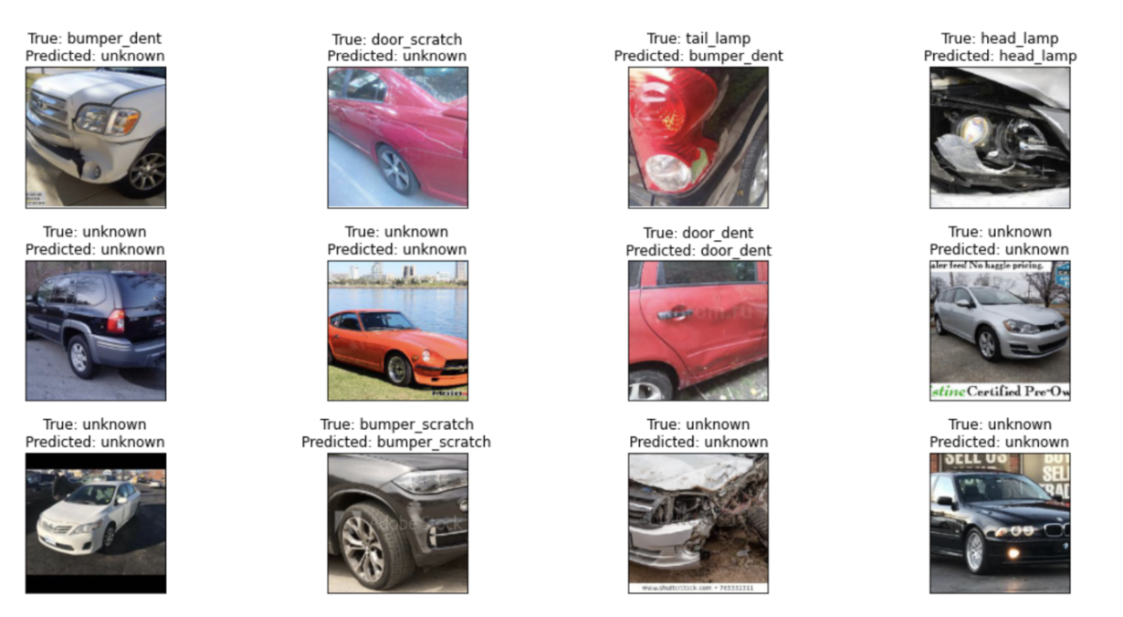
Vehicle damage prediction

Slide 14
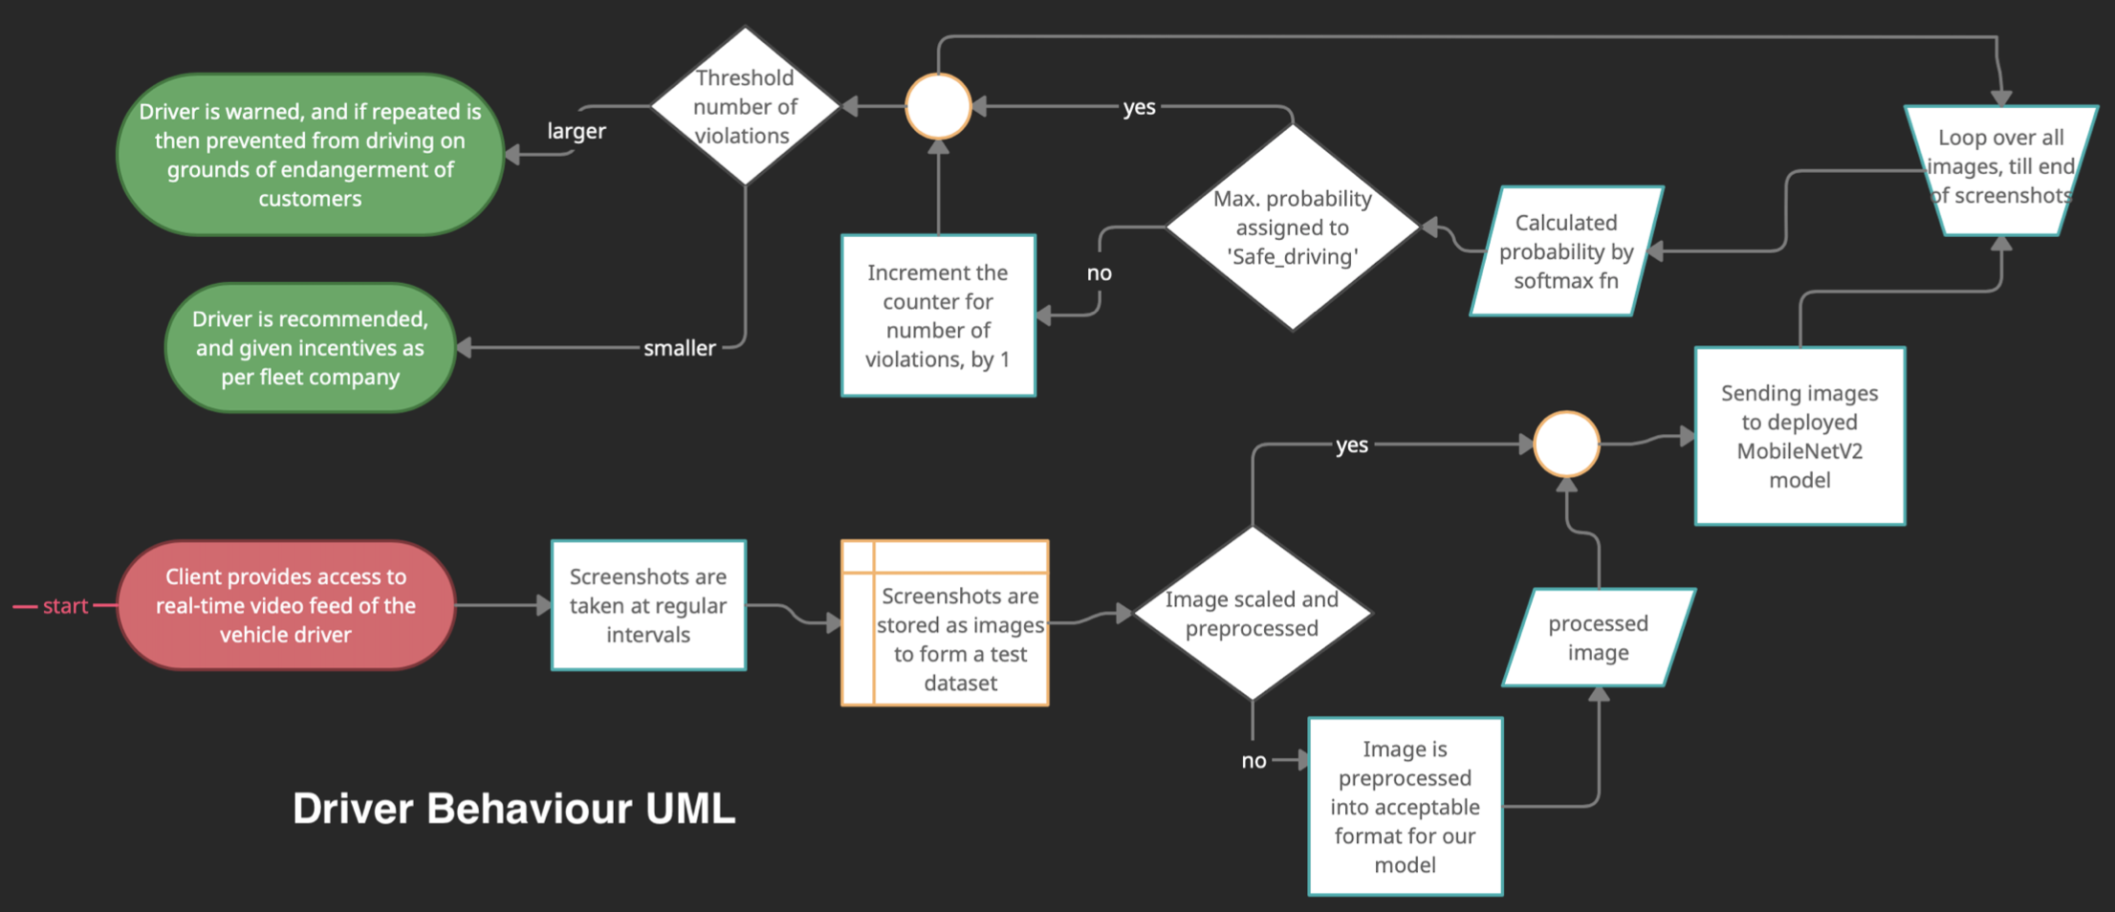
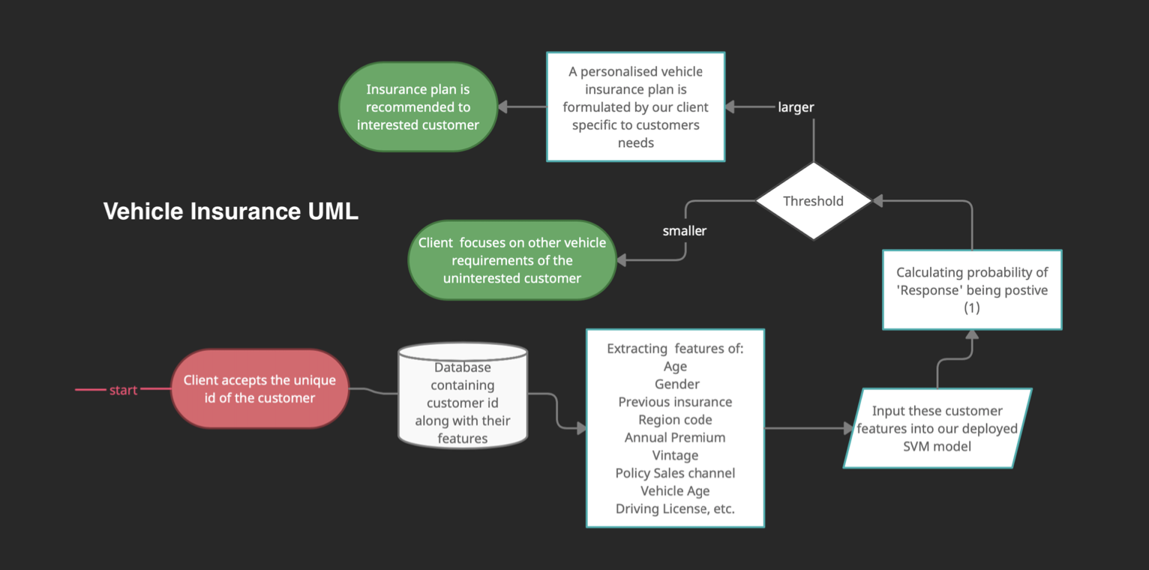
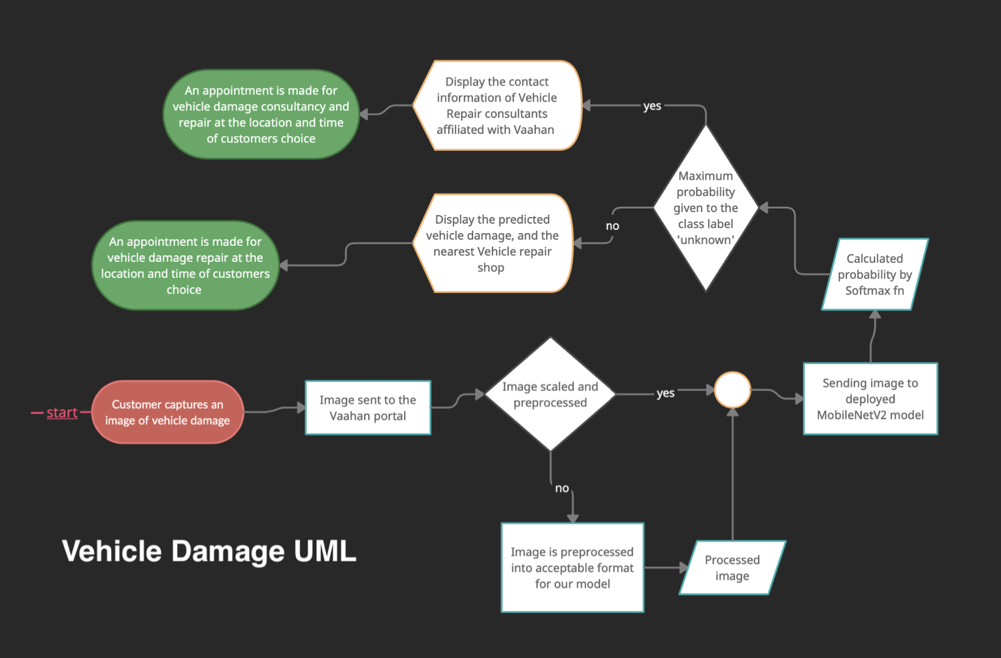
Reports and diagrams
High level Activity object and Class Diagrams using UML:
The three diagrams given below represent the high level understanding of the working of the VAAHAN portal
The flow of information from the start (customer/client) to end (provided service) have been depicted in a way that is easy to follow, where the diagrams help keep track of processes involved.

Slide 15
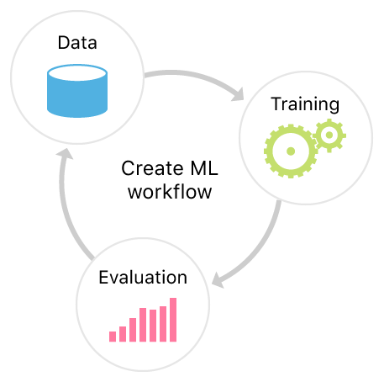
Auto-code documentation generation: The code present in the notebooks have been documented while being created. This makes it efficient and easy for others to refer to documentation to understand the code written, and serves as explanation to the various functions and variables that were utilized. The same can be found in the zip folder submission.
Model Testing and Training: A detailed report on the model descriptions used for each of our three services, along with the training log files have been compiled into a pdf submission.
This report also contains the accuracies obtained as VAAHAN tests our models on unseen test data, and serves as a proof that we use state-of-the-art facilities while aiming to provide the best to our customer base.
A brief summary of our code is as follows in the upcoming three slides:

Slide 16
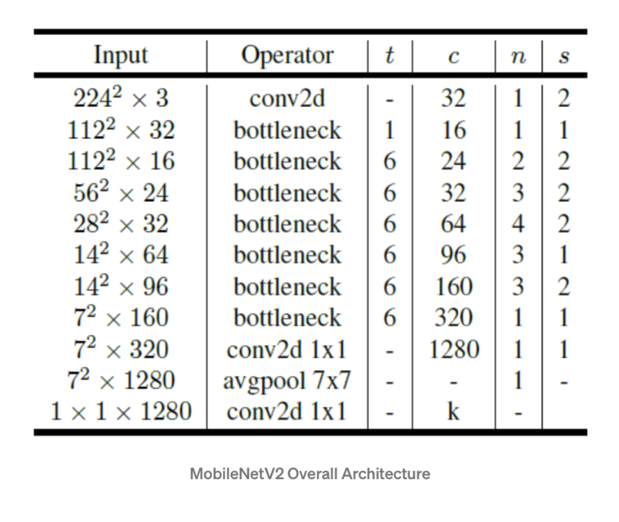
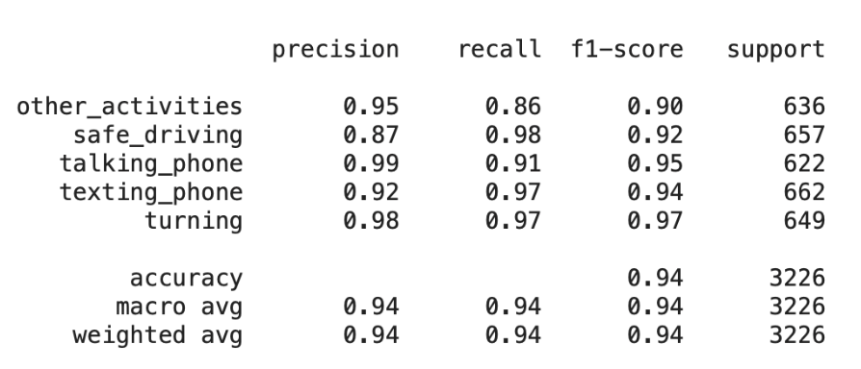
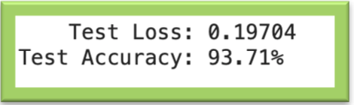
DRIVER Behavior classification
Dataset: 10766 colored images of driver behavior and their assigned class labels [safe driving/ turning/ texting phone/ talking phone/ other activities]
We utilize a MobileNetV2 architecture pretrained on the ImageNet Dataset for the purpose of this classification. The training occurs over 25 epochs, subject to the early stopping condition callback to prevent overfitting
Training Accuracy: 98.22 %
Training Loss: 0.0539
Validation Accuracy: 0.0675
Validation Loss: 97.54%

Slide 17
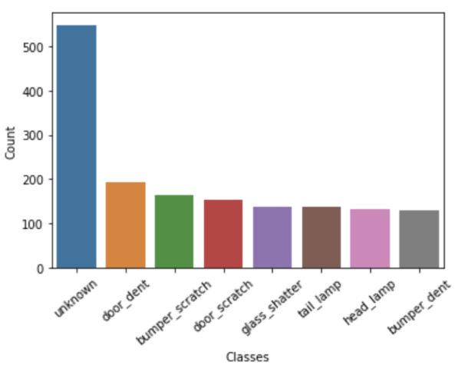
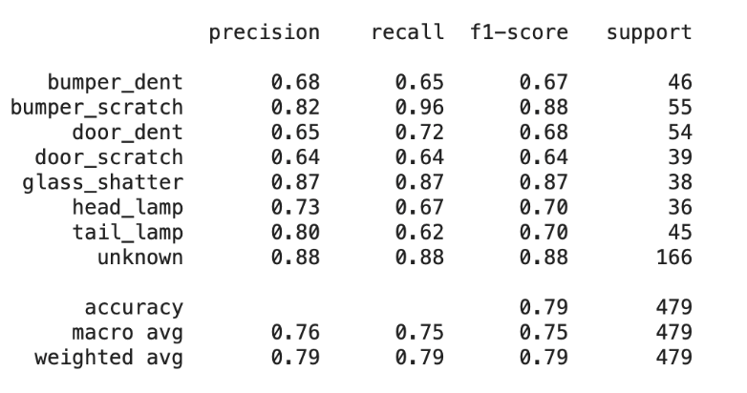
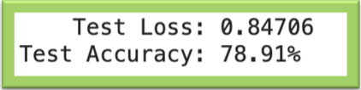
Vehicle damage prediction
Dataset includes 1594 coloured images of various damaged vehicle parts and their corresponding class label [door dent, bumper scratch, door scratch, glass shatter, tail lamp, head lamp, bumper dent]
Similar to the driver behavior service, we utilized a MobileNetV2 architecture to predict the type of damage done to the car based on the colored image received.
The training is done over 50 epochs, subject to Early stopping condition callback to prevent overfitting.
Training accuracy: 100%
Training loss: 0.0087
Validation accuracy: 100%
Validation loss: 0.0072

Slide 18
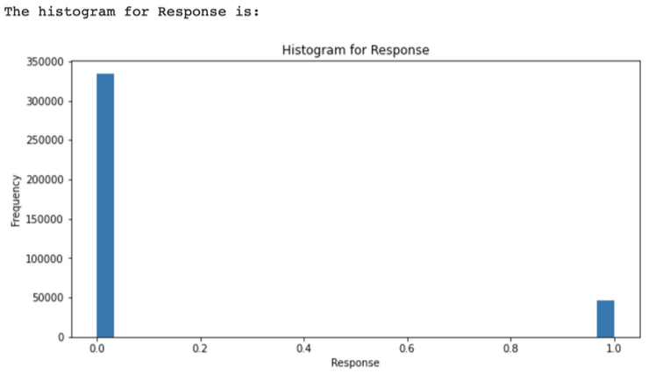
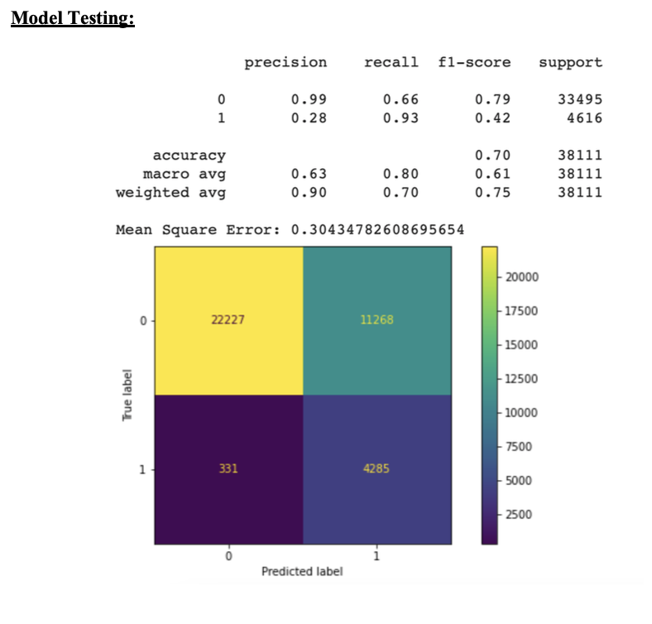
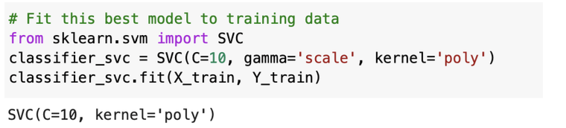
Vehicle insurance customer interest
Dataset contains 381109 records of customers and their features along with their corresponding Response to whether they would purchase vehicle insurance or not
For the purpose of our project, due to limited computational power, only a section of this shuffled dataset was utilized to train our model
Gauging the highly skewed dataset in terms of the 'Response' class label, we perform down sampling of the majority class to avoid any misinformed metric of accuracy.
We utilized a Support Vector Machine (SVM) model to classify our customer interest in vehicle insurance, with hyperparameter tuning performed manually for optimal values of C and kernel.
Testing Accuracy: 70%

Slide 19
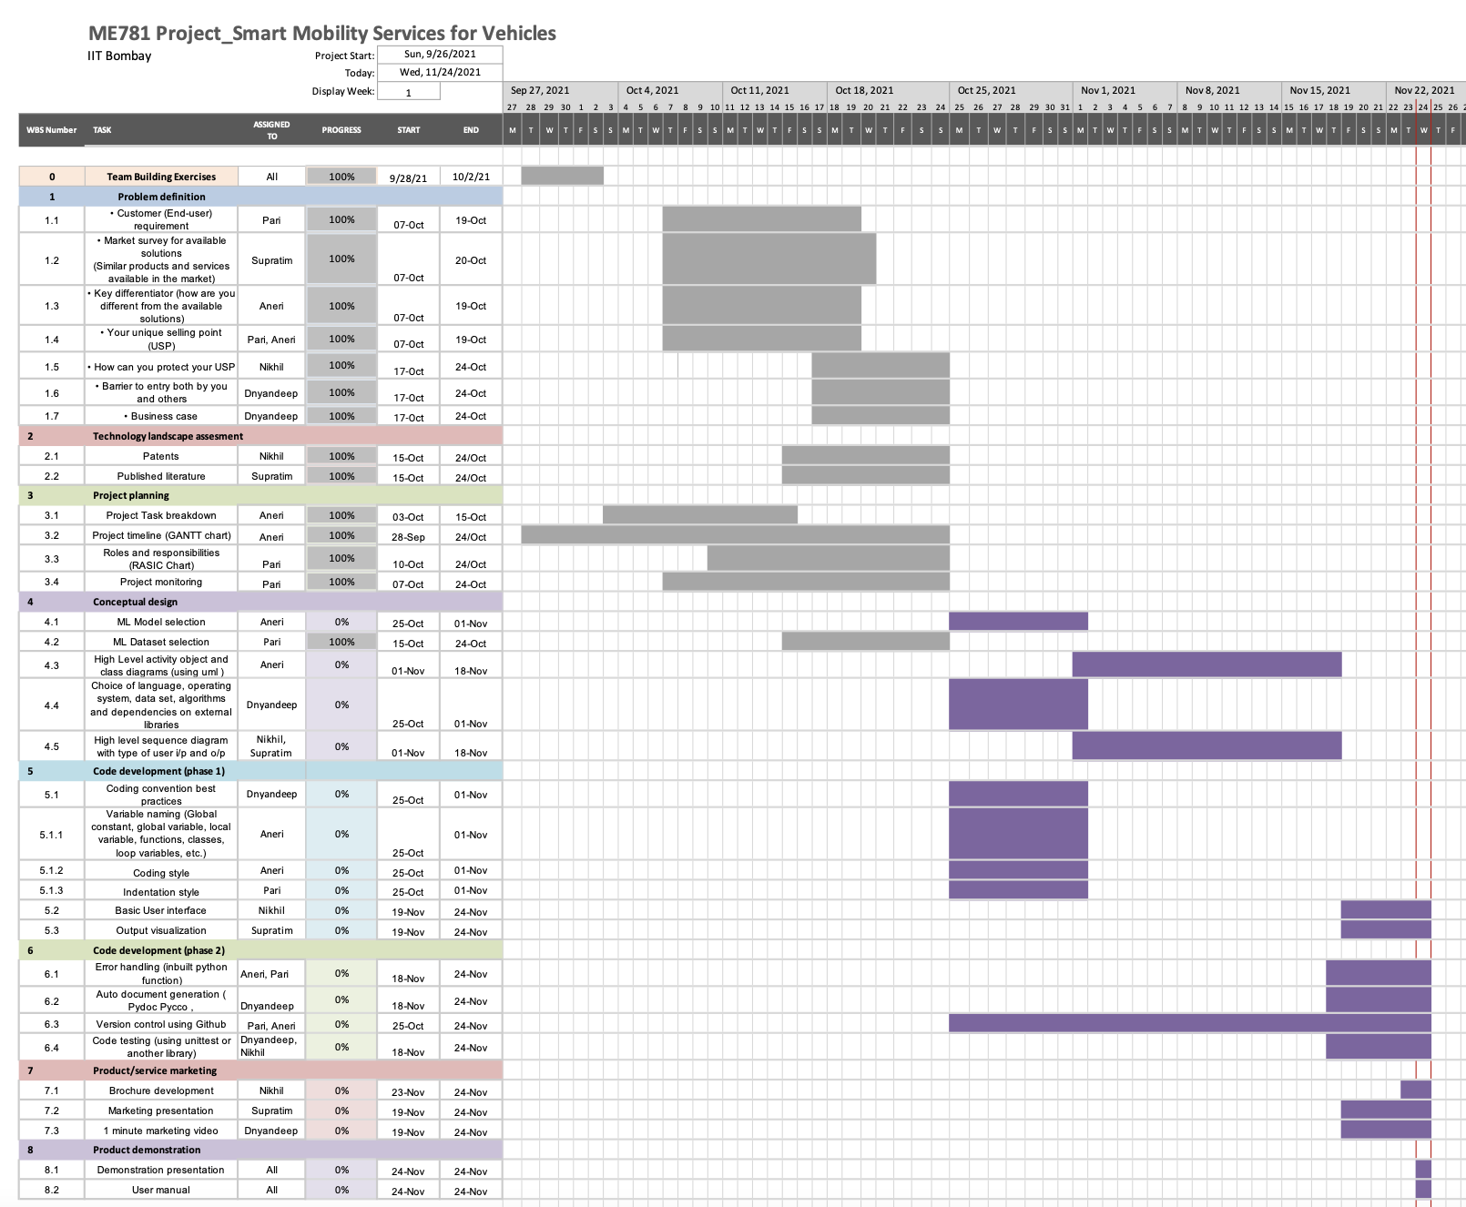
GANNT CHART

Slide 20

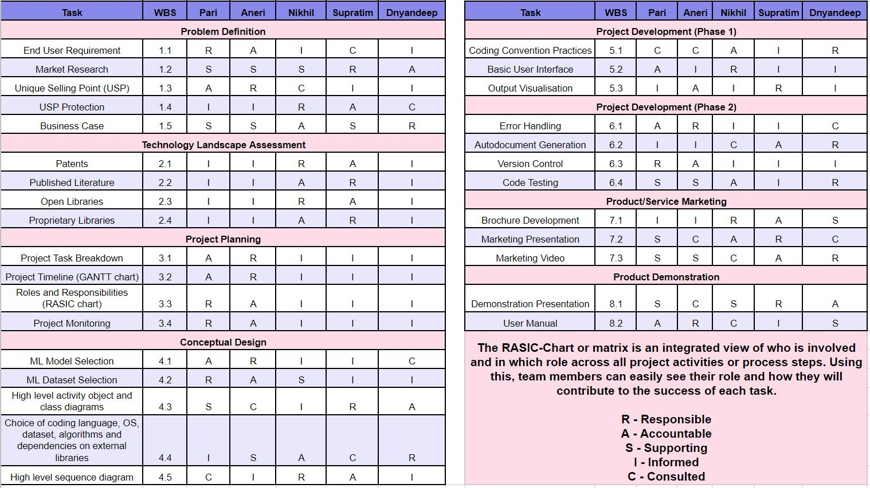
RASIC CHART

Slide 21
THANK YOU !

